Slide 1
Design Data Implementation

Slide 2
Design for Azure Storage solutions

Slide 3
Azure Storage Account General Properties
TLS
Public REST Endpoint
Scalability
Features
Standard (HDD) or Premium (SDD)
500 TB per account
20k IOPS per service type
10-20 Gbps ingress
20-30 Gbps egress
Server Side Encryption (SSE)
Geo-redundant storage
Hot, cold, archive tiers use same API
Anonymous access Blob Containers
Shared Access Signatures
Shared-Key Auth
HOT
COOL
ARCHIVE
Blobs
VM VHDs
Tables
Queues
Files

Slide 4
Azure Storage Account Services
IaaS
PaaS
Virtual machines
Existing frameworks
Web and mobile
Microservices
Serverless Compute
Storage
Networking
Disks
Persistent disks for Azure IaaS VMs
Premium Storage Disks option: SSD based, high IOPS, low latency
Files
Fully Managed File Shares in the Cloud
SMB and REST access
“Lift and shift” legacy apps
Blobs
Highly scalable, REST based cloud object store
Block Blobs: Sequential file I/O
Cool Tier Available
Page Blobs: Random-write pattern data
Append Blobs
Tables
Massive auto-scaling NoSQL store
Dynamic scaling based on load
Scale to PBs of table data
Fast key/value lookups
Queues
Reliable queues at scale for cloud services
Decouple and scale components
Message visibility timeout and update message to protect against unreliable dequeuers
Built on a unified Distributed Storage System
Durability, Encryption at Rest, Strongly Consistent Replication, Fault Tolerance, Auto Load-Balancing

Slide 5
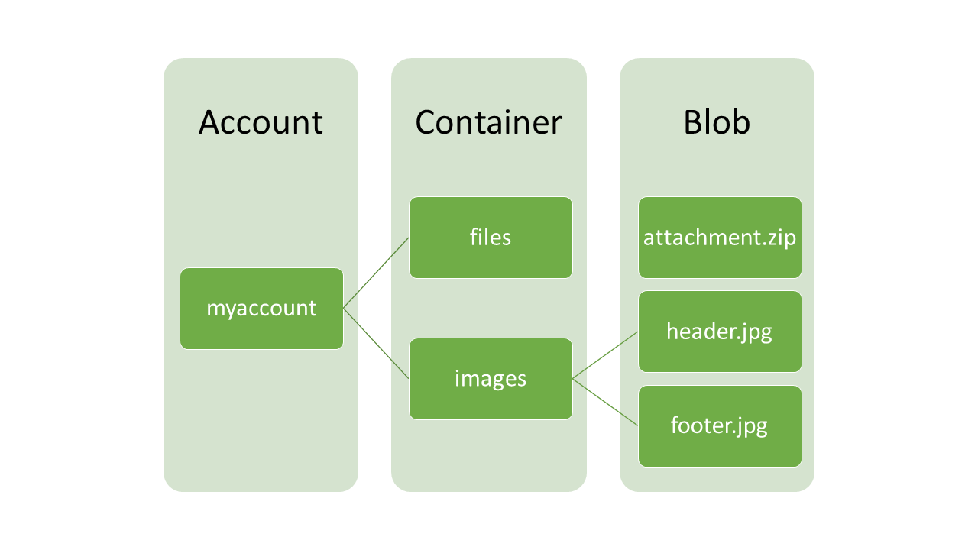
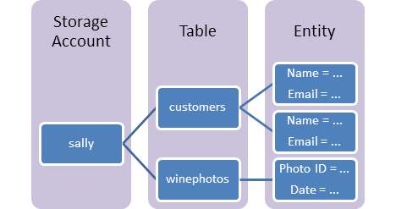
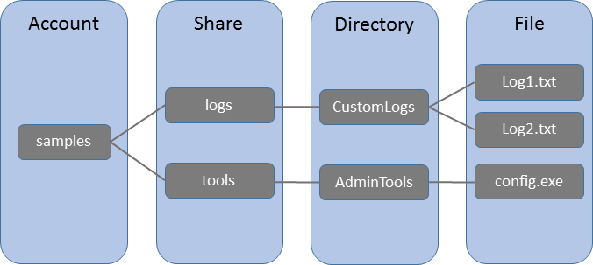
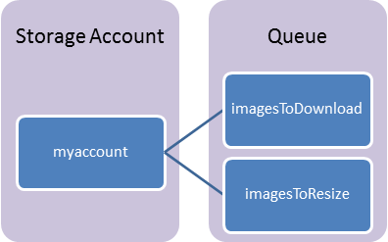
Azure Storage Service Profiles
Blob Storage
Azure Table
File Storage
Azure Queue

Slide 6
Azure Storage Account Types
General-purpose v1:
Only storage type that works with classic deployment model
Supports use of Blobs, Tables, Queues, and files
Only uses hot storage method
Upgrade path to v2 via PowerShell/CLI
Blob Storage Accounts:
Only supports use of Block Blobs
Aligns to capabilities of general-purpose v2
Blob Storage Types:
Block Blobs: block level storage ideal for storing text or binary files
Append Blobs: similar to block blobs, they’re made of blocks but optimized for append ops and ideal for logging scenarios
Page Blobs: are more efficient for frequent read/write operations and are the type used to store VHDs for Azure VMs
General-purpose v2:
Also supports use of Blobs, Tables, Queues, and files
Enables cool and archive access tier
Each account has default access tier that can be hot or cool
Each blob can change access tier to hot, cool or archive
Changing an access tier can have one-time cost implications

Slide 7
Know the various storage types and their uses. For example, many times you can use Queues to decouple components of a system.
aka.ms/azure/storage, how they are alike & how they are different

Slide 8
Storage Queues vs Service Bus Queues
Comparison Criteria | Storage queues | Service Bus Queues
Maximum queue size | 500 TB (limited to a single storage account capacity) | 1 GB to 80 GB (defined upon creation of a queue and enabling partitioning – see the “Additional Information” section)
Maximum message size | 64 KB (48 KB when using Base64 encoding) Azure supports large messages by combining queues and blobs – at which point you can enqueue up to 200 GB for a single item. | 256 KB or 1 MB (including both header and body, maximum header size: 64 KB). Depends on the service tier.
Maximum message TTL | 7 days | TimeSpan.Max
Maximum number of queues | Unlimited | 10,000 (per service namespace)
Maximum number of concurrent clients | Unlimited | Unlimited (100 concurrent connection limit only applies to TCP protocol-based communication)

Slide 9
Storage Queues vs Service Bus Queues MORE
Comparison Criteria | Storage queues | Service Bus Queues
Ordering guarantee | No For more information, see the first note in the “Additional Information” section. | Yes - First-In-First-Out (FIFO) (through the use of messaging sessions)
Delivery guarantee | At-Least-Once | At-Least-Once, At-Most-Once
Atomic operation support | No | Yes
Receive behavior | Non-blocking (completes immediately if no new message is found) | Blocking with/without timeout (offers long polling, or the "Comet technique") Non-blocking (through the use of .NET managed API only)
Push-style API | No | Yes OnMessage and OnMessage sessions .NET API.
Receive mode | Peek & Lease | Peek & Lock, Receive & Delete
Exclusive access mode | Lease-based | Lock-based
Lease/Lock duration | 30 seconds (default), 7 days (maximum) | 60 seconds (default) You can renew a message lock using the RenewLock
Lease/Lock precision | Message level | Queue level
Batched receive | Yes (explicitly specifying message count when retrieving messages, up to a maximum of 32 messages) | Yes (implicitly enabling a pre-fetch property or explicitly through the use of transactions)
Batched send | No | Yes (through the use of transactions or client-side batching)

Slide 10
Azure Storage Account Security
Shared Key Authentication:
Two storage account keys that are 512-bit strings that give access to data for all Storage Account services
Blob containers can be set to give anonymous read access for individual blobs or for the whole container
Shared Access Signatures (SAS):
Contain access rules and an account key in an encrypted query string included with REST calls
Service-level SAS is scoped to specific resources within a storage account
Account-level SAS is scoped to access anything in the storage account
SAS policies can be used on Blob containers, a Table, a Queue, or a file share and used as basis for SAS URIs; allows revocation
Network Firewalls:
Azure VNETs can use service endpoints and service tags to reference Azure Storage service IP ranges for direct routing and ACLs
Azure Storage accounts can use firewall rules to restrict network access by IP range
Data Encryption:
Data in transit is encrypted using TLS security; HTTP access is also allowed but can be turned off
Azure files supports encryption for data in transit with SMB 3.0 on Windows only; SMB 2.0 or File Shares on Linux are not encrypted
Storage Service Encryption (SSE) encrypts all data at rest in an Azure Storage Account using MSFT managed keys only
Client-side Encryption is enabled using an SDK to programmatically encrypt data as its being stored in a Storage Account
Azure Disk Encryption:
Encrypt VHDs using BitLocker for Windows and DM-Crypt for Linux
SSE only encrypts new writes so its good for VM data disks, but marketplace images are unencrypted until new writes occur

Slide 11
Read
Azure Storage | Shared Access Signature - SAS
SQL Database – same model as on-premises
Download and Use:
Microsoft Azure Storage Explorer is a standalone app from Microsoft that allows you to easily work with Azure Storage data on Windows, macOS and Linux. http://storageexplorer.com/

Slide 12
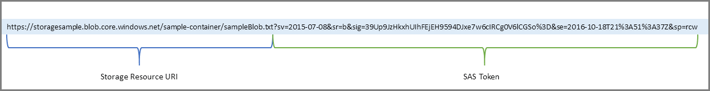
Example of SAS token
3.1.3 Exam Tip!

Slide 13
Storage for VM disks (Page Blobs)
 | Azure Premium Disk | Azure Standard Disk
Disk Type | Solid State Drives (SSD) | Hard Disk Drives (HDD)
Overview | SSD-based high-performance, low-latency disk support for VMs running IO-intensive workloads or hosting mission critical production environment | HDD-based cost effective disk support for Dev/Test VM scenarios
Scenario | Production and performance sensitive workloads | Dev/Test, non-critical, Infrequent access
Disk Size | P4: 32 GB (Managed Disks only) P6: 64 GB (Managed Disks only) P10: 128 GB P20: 512 GB P30: 1024 GB P40: 2048 GB P50: 4095 GB | Unmanaged Disks: 1 GB – 4 TB (4095 GB) Managed Disks: S4: 32 GB S6: 64 GB S10: 128 GB S20: 512 GB S30: 1024 GB S40: 2048 GB S50: 4095 GB
Max Throughput per Disk | 250 MB/s | 60 MB/s
Max IOPS per Disk | 7500 IOPS | 500 IOPS

Slide 14
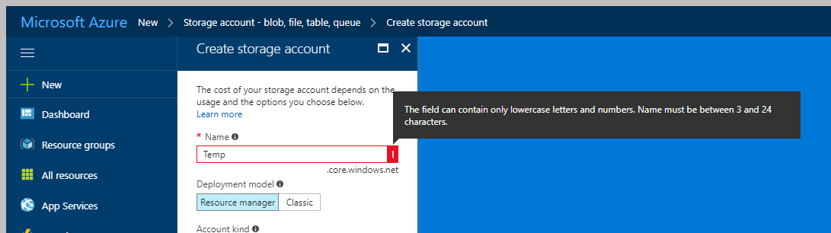
The storage account name should always be lowercase and unique within *.core.windows.net namespace.
3.1.4 Exam Tip!

Slide 15
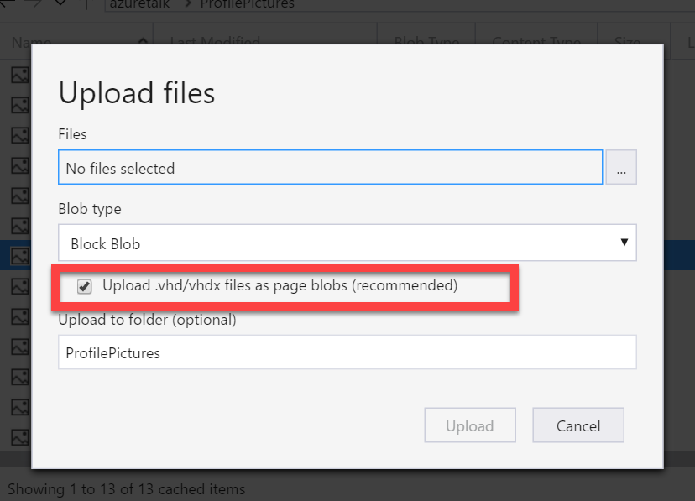
Choose appropriate blob type for uploading VHD. If VHD files are uploaded in block blob you can’t use those.
3.1.5 Exam Tip!

Slide 16
Storage Account Cost Model
Cost Components:
Storage cost: the cost of the provisioned data
Data access cost: data retrieval when changing access storage tier from cool to hot
Transaction costs: read, write, list, and create container operations
Geo-replication data transfer costs: data leaving an Azure region via built-in replication features
Outbound data transfer: data leaving an Azure region for any use other than built-in replication features
 | Hot storage tier | Cool storage tier | Archive storage tier
Availability | 99.9% | 99% | N/A
Availability (RA-GRS reads) | 99.99% | 99.9% | N/A
Usage charges | Higher storage costs, lower access and transaction costs | Lower storage costs, higher access and transaction costs | Lowest storage costs, highest access and transaction costs
Minimum object size | N/A | N/A | N/A
Minimum storage duration | N/A | 30 days (GPv2 only) | 180 days
Latency (Time to first byte) | milliseconds | milliseconds | < 15 hrs
Scalability and performance targets | Same as general-purpose storage accounts | Same as general-purpose storage accounts | Same as general-purpose storage accounts

Slide 17
Azure Storage Replication Options
Replication strategy | LRS | ZRS | GRS | RA-GRS
Data is replicated across multiple datacenters. | No | Yes | Yes | Yes
Data can be read from a secondary location as well as the primary location. | No | No | No | Yes
Designed to provide _ durability of objects over a given year. | at least 99.999999999% (11 9's) | at least 99.9999999999% (12 9's) | at least 99.99999999999999% (16 9's) | at least 99.99999999999999% (16 9's)

Slide 18
Azure Storage Scalability Targets
Resource | Default Limit
Number of storage accounts per subscription | 200
Max storage account capacity | 500 TiB
Max number of blob containers, blobs, file shares, tables, queues, entities, or messages per storage account | No limit
Maximum request rate per storage account | 20,000 requests per second
Max ingress per storage account (US Regions) | 10 Gbps if GRS/ZRS enabled, 20 Gbps for LRS
Max egress per storage account (US Regions) | 20 Gbps if RA-GRS/GRS/ZRS enabled, 30 Gbps for LRS
Max ingress per storage account (Non-US regions) | 5 Gbps if GRS/ZRS enabled, 10 Gbps for LRS
Max egress per storage account (Non-US regions) | 10 Gbps if RA-GRS/GRS/ZRS enabled, 15 Gbps for LRS
Notes:
Reference: https://docs.microsoft.com/en-us/azure/azure-subscription-service-limits#storage-limits

Slide 19
Scalability targets are planned to increase in early 2018 so stay posted on the changes depending on when you take the exam.
500 TB → 5 PB storage capacity
20k → 50k requests/sec
20 Gbps → 50 Gbps bandwidth

Slide 20
Azure Blob Storage Scale Targets
Resource | Target
Max size of single blob container | 500 TiB
Max number of blocks in a block blob or append blob | 50,000 blocks
Max size of a block in a block blob | 100 MiB
Max size of a block blob | 50,000 X 100 MiB (approx. 4.75 TiB)
Max size of a block in an append blob | 4 MiB
Max size of an append blob | 50,000 x 4 MiB (approx. 195 GiB)
Max size of a page blob | 8 TiB
Max number of stored access policies per blob container | 5
Target throughput for single blob | Up to 60 MiB per sec, or up to 500 requests per sec
Notes:
Reference: https://docs.microsoft.com/en-us/azure/azure-subscription-service-limits#storage-limits

Slide 21
Sufficient bandwidth on VM
Make sure sufficient bandwidth is available on your VM to drive disk traffic, as described in Premium Storage-supported VMs. Otherwise, your disk throughput and IOPS is constrained to lower values. Maximum throughput and IOPS are based on the VM limits, not on the disk limits described in the preceding table.
How to monitor for disk I/O throttling: https://aka.ms/VMDiskThrottling
https://docs.microsoft.com/en-us/azure/storage/storage-premium-storage#scalability-and-performance-targets

Slide 22
Premium storage accounts Scalability
… have the following scalability targets:+
Total account capacity | Total bandwidth Locally redundant storage account
Disk capacity: 35 TB Snapshot capacity: 10 TB | Up to 50 gigabits per second for inbound¹ + outbound² ¹ All data (requests) that are sent to a storage account+ ² All data (responses) that are received from a storage account
https://docs.microsoft.com/en-us/azure/storage/storage-premium-storage#scalability-and-performance-targets

Slide 23
If Using Storage Spaces Striping
If you stripe premium storage data disks by using Storage Spaces, set up Storage Spaces with 1 column for each disk that you use. Otherwise, overall performance of the striped volume might be lower than expected because of uneven distribution of traffic across the disks. By default, in Server Manager, you can set up columns for up to 8 disks. If you have more than 8 disks, use PowerShell to create the volume. Specify the number of columns manually. Otherwise, the Server Manager UI continues to use 8 columns, even if you have more disks. For example, if you have 32 disks in a single stripe set, specify 32 columns. To specify the number of columns the virtual disk uses, in the New-VirtualDisk PowerShell cmdlet, use the NumberOfColumns parameter. For more information, see Storage Spaces Overview and Storage Spaces FAQs.
https://docs.microsoft.com/en-us/azure/storage/storage-premium-storage#scalability-and-performance-targets

Slide 24
Pay Attention to I/O vs IOPs
If your disk traffic mostly consists of small I/O sizes, your application likely will hit the IOPS limit before the throughput limit. However, if the disk traffic mostly consists of large I/O sizes, your application likely will hit the throughput limit first, instead of the IOPS limit. You can maximize your application's IOPS and throughput capacity by using optimal I/O sizes. Also, you can limit the number of pending I/O requests for a disk.
https://docs.microsoft.com/en-us/azure/storage/storage-premium-storage#scalability-and-performance-targets

Slide 25
Azure Files Scale Targets
Resource | Target
Max size of a file share | 5 TiB
Max size of a file in a file share | 1 TiB
Max number of files in a file share | No limit
Max IOPS per share | 1000 IOPS
Max number of stored access policies per file share | 5
Maximum request rate per storage account | 20,000 requests per second for files of any valid size³
Target throughput for single file share | Up to 60 MiB per second
Maximum open handles for per file | 2000 open handles
Maximum number of share snapshots | 200 share snapshots

Slide 26
Azure Queue Storage Scale Targets
Resource | Target
Max size of single queue | 500 TiB
Max size of a message in a queue | 64 KiB
Max number of stored access policies per queue | 5
Maximum request rate per storage account | 20,000 messages per second assuming 1 KiB message size
Target throughput for single queue (1 KiB messages) | Up to 2000 messages per second

Slide 27
Azure Table Storage Scale Targets
Resource | Target
Max size of single table | 500 TiB
Max size of a table entity | 1 MiB
Max number of properties in a table entity | 252
Max number of stored access policies per table | 5
Maximum request rate per storage account | 20,000 transactions per second (assuming 1 KiB entity size)
Target throughput for single table partition (1 KiB entities) | Up to 2000 entities per second

Slide 28
Transferring Data
Azure API: The Azure REST API or SDK, namely the Azure Storage Data Movement Library, is designed for high-performance copying of data to and from Azure
AzCopy Utility: Windows command line utility designed for high-performance data transfer
Azure PowerShell/CLI: Write scripts to push data for any scenario
Azure Import/Export: Enables data transfer by securely shipping up to 10 TB external drive to Microsoft
Azure Data Box: Microsoft appliance to securely transfer large amounts of data (100 TB)
Virtual appliances: Storage virtual appliances from vendors like Nasuni or NetApp
StorSimple: Azure first party service to tier data from on-prem to Azure
ExpressRoute: Enabling a high performance network throughput for faster data transfer using above options

Slide 29
Design for relational database storage

Slide 30
Database as-a-Service
Read/Write
Long Term Retention
Read
Primary
Azure Backup
Readable Secondary
Reports
Applications
Sync Commit
Async Commit
Secondary
Secondary
Azure SQL DB
Secondary
Azure SQL Database
Built-in local high availability with 99.99% SLA
Automatic backups (full, differential, trans log) with optional long term retention
Active geo-replication enables read replicas in a secondary region with a single DNS endpoint
Elastic Database Pools enables resource shared for more efficient cost management
Azure offers this managed service for SQL Server, MySQL, PostgreSQL

Slide 31
Azure SQL DB Tiers
 | Basic | Standard | Premium | Premium RS
Target workload | Development and production | Development and production | Development and production | Workload that can tolerate data loss up to 5-minutes due to service failures
Uptime SLA | 99.99% | 99.99% | 99.99% | N/A
Backup retention | 7 days | 35 days | 35 days | 35 days
CPU | Low | Low, Medium, High | Medium, High | Medium
IO throughput | Low | Medium | Order of magnitude higher than Standard | Same as Premium
IO latency | Higher than Premium | Higher than Premium | Lower than Basic and Standard | Same as Premium
Columnstore indexing and in-memory OLTP | N/A | N/A | Supported | Supported

Slide 32
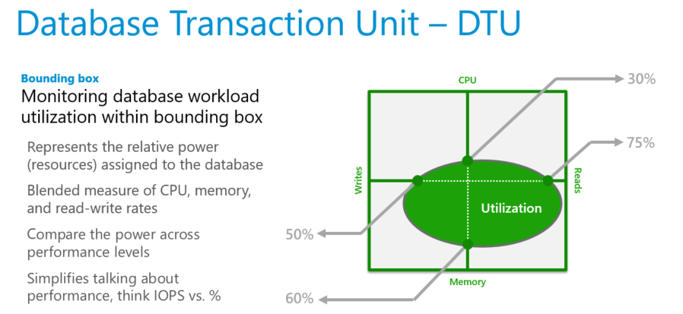
Choosing DB Performance Level
DTU Calculator

Slide 33
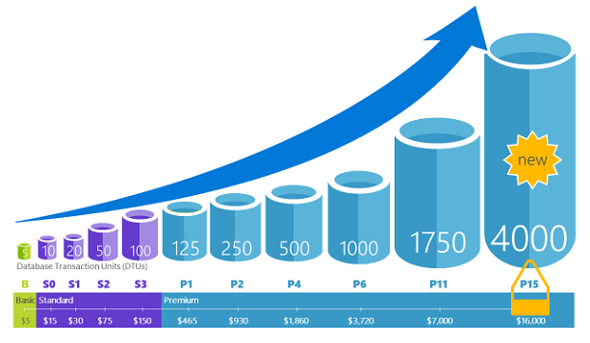
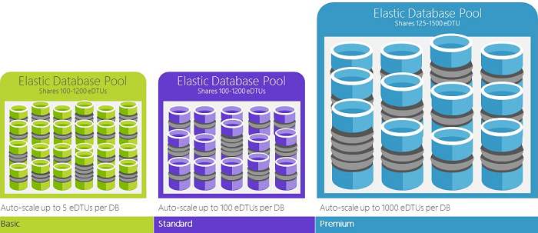
Database Types
Single Databases
Elastic Database Pools
Fully managed redundancy, backups, and upgrades
Wide range of sizes and performance tiers
Majority of feature parity with SQL Server
A shared pool of eDTUs by multiple DBs enables cost efficiency
Auto-scale within set parameters
Simplified management of large number of DBs
Adjust eDTUs for the pool as needed with no down time

Slide 34
Performance Level and Storage Size Limits
Single Databases
 | Basic | Standard | Premium | Premium RS
Maximum storage size* | 2 GB | 1 TB | 4 TB | 1 TB
Maximum DTUs | 5 | 3000 | 4000 | 100
Elastic Pools
 | Basic | Standard | Premium | Premium RS
Maximum storage size per database* | 2 GB | 1 TB | 1 TB | 1 TB
Maximum storage size per pool* | 156 GB | 4 TB | 4 TB | 1 TB
Maximum eDTUs per database | 5 | 3000 | 4000 | 1000
Maximum eDTUs per pool | 1600 | 3000 | 4000 | 1000
Maximum number of databases per pool | 500 | 500 | 100 | 100
Notes:
Reference: https://docs.microsoft.com/azure/sql-database/sql-database-dtu-resource-limits

Slide 35
SQL DB Security
Connectivity:
All connections are over a public endpoint and require TLS encryption for data in transit
Firewall rules limit connectivity by originating IP range
Service endpoints with an Azure VNET allow direct connectivity
Authentication:
SQL Authentication
Azure AD Authentication
Authorization:
Account database role and object level permissions
Impersonation
Row-level security
Data masking
Stored procedures
Security:
Transparent Database Encryption (TDE) using Microsoft or customer managed keys
Cell-level encryption to encrypt specific columns or cells of data
Always Encrypted for data in use
SQL database auditing to maintain regulator compliance

Slide 36
SQL DB Availability
Long-term data retention: Use Azure Backup to retain beyond 7-35 day window
Active Geo-Replication: Replicate an asynchronous (readable) secondary to another region
Failover Groups: Automatic failover of active geo-replicated secondary's using VIPs
Capability | Basic tier | Standard tier | Premium tier
Point in Time Restore from backup | Any restore point within 7 days | Any restore point within 35 days | Any restore point within 35 days
Geo-restore from geo-replicated backups | ERT < 12h, RPO < 1h | ERT < 12h, RPO < 1h | ERT < 12h, RPO < 1h
Restore from Azure Backup Vault | ERT < 12h, RPO < 1 wk | ERT < 12h, RPO < 1 wk | ERT < 12h, RPO < 1 wk
Active geo-replication | ERT < 30s, RPO < 5s | ERT < 30s, RPO < 5s | ERT < 30s, RPO < 5s

Slide 37
MySQL, PostgreSQL
Pricing tier features | Basic | Standard | Premium (not available)
Maximum Compute Units | 100 | 800
Maximum total storage | 1 TB | 1 TB
Storage IOPS guarantee | N/A | Yes
Maximum storage IOPS | N/A | 3,000
Database backup retention period | 7 days | 35 days
SLA | 99.99% | 99.99%
HA | Regional only | Regional only

Slide 38
Migrate to Azure SQL DB
Data Migration Assistant (DMA): copies database, deploys fixes, migrates copy; requires downtime
Transactional Replication: requires some setup and continuous connectivity but does not require downtime
Import DB: import from on-prem to Azure using BACPAC file
Azure SQL Data Sync (Preview): bi-directional connectivity between a group of Azure SQL DB and SQL Server
Azure DB Migration Service (Preview): migrate from multiple sources or DB types to target DB

Slide 39
3.1.1: A title company needs to provide access to storage for people to upload scans of documents that they signed. There are time limits to when the documents are needed. Which approach should be used to provide access?
Create a service and set up the valid dates in a database that will be read
Use an SAS and set the expiration time and date for the user.
Set up Azure AD with permissions for the user that limit the time in which she can upload documents.
Open up the Blob storage container to public access so that the user can add the document even if she is late.

Slide 40
Azure might update to change feature availability. The exam is updated over time, as well, to reflect these changes. However, because of the way Azure is steadily being updated, the newest features might not be on the exams.

Slide 41
Performance levels of the database are important to a company, and the ability to change this at times is equally important. For example, the limits of each level of SQL Database can help the architect to determine the minimum level needed to satisfy those needs.

Slide 42
Design for NoSQL Storage

Slide 43
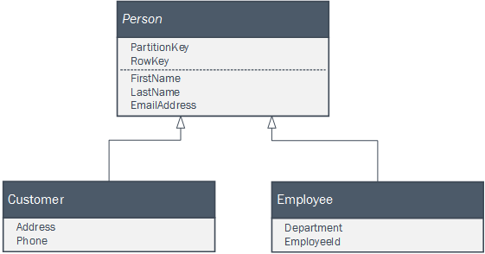
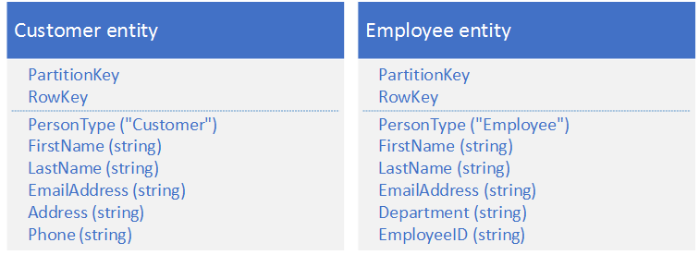
Azure Table Storage
Features:
Partition key: determines the partition to use within storage service
RowKey: used with partition key to create clustered index, the only index created
Guidelines for Read Design:
Specify both PartitionKey and RowKey in your queries.
Table storage is cheap so consider storing the same entity multiple times (with different keys) to enable more efficient queries.
Table storage is cheap so consider denormalizing your data.
Use compound key values for alternate keyed access paths to entities.
Use query projection. You can reduce the amount of data that you transfer over the network by using queries that select just the fields you need
Guidelines for Write Design:
Choose keys that enable you to spread your requests across multiple partitions at any point of time.
Avoid spikes in traffic.
Don't necessarily create a separate table for each type of entity.
Consider the maximum throughput you must achieve.

Slide 44
Redis Cache
 | Basic Basic cache which is ideal for development/testing. | Standard Production ready cache with master/slave replication. | Premium Enterprise ready tier which can be used as a cache and persist data. Designed for maximum scale and enterprise integration.
Cache | Yes | Yes | Yes
Replication and failover | - | Yes | Yes
SLA | - | 99.9% | 99.9%
Configure Redis (keyspace notifications etc.) | - | Yes | Yes
Redis data persistence | - | - | Yes
Redis cluster | - | - | Yes
Scale out to multiple cache units | - | - | Yes
Azure Virtual Network | - | - | Yes
Memory size | 250 MB–53 GB | 250 MB–53 GB | 6 GB–530 GB
Network performance | Low to high | Low to high | Moderate to highest
Maximum number of client connections | 256–20,000 | 256–20,000 | 7,500–40,000

Slide 45
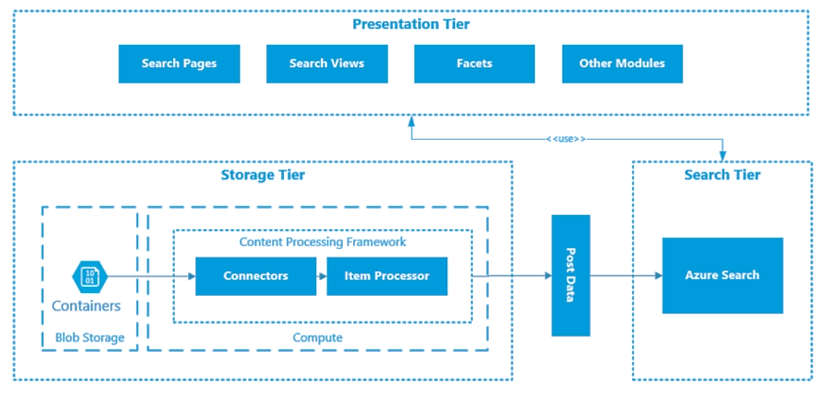
Azure Search Architecture
Features
Query syntax – simple, Lucene
56 Languages
Search suggestions
Hit highlighting
Faceted navigation
Geo-special support
Filters, sorting, paging
Fully managed, highly available
Scoring profiles
Data connectors
Testing tools
Search analytics

Slide 46
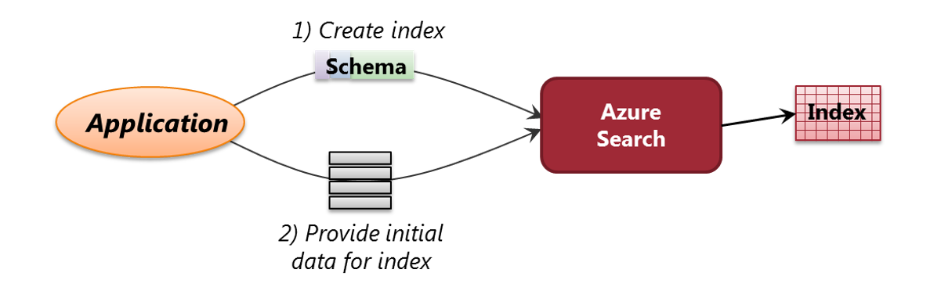
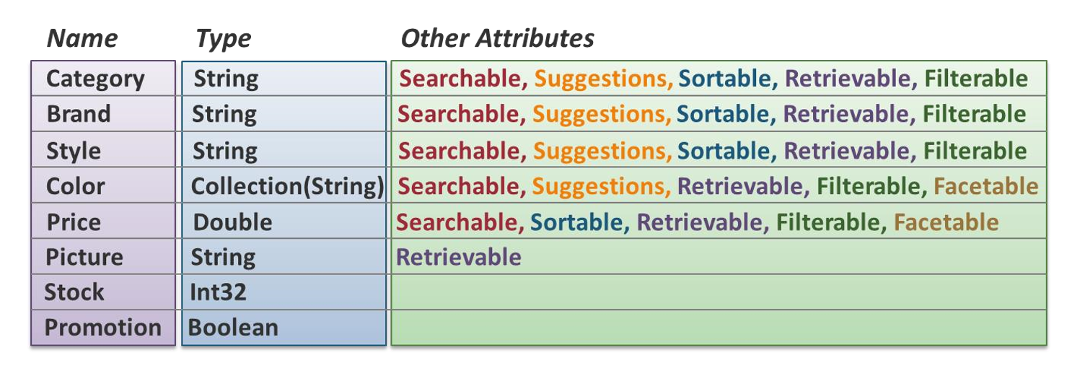
Create and Populate an Index

Slide 47
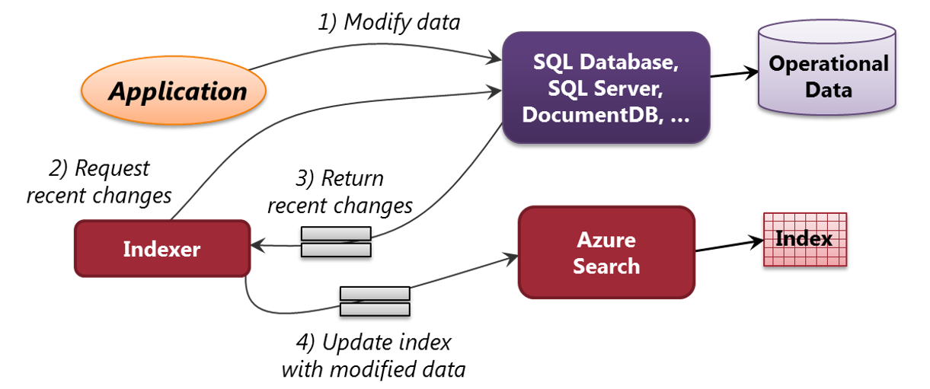
Update Indexes
Azure Search

Slide 48
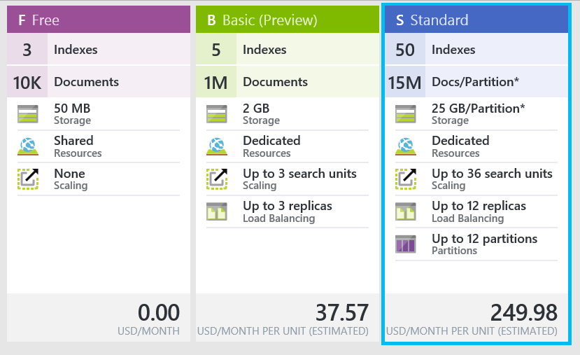
Cost and Scale
Search Units
Service Tiers
Partitions
Replicas
(Replicas x Partitions)

Slide 49
Design for CosmosDB Storage

Slide 50
CosmosDB Key Capabilities
Enable customers to elastically scale throughput and storage based on demand, globally
Enable customers to build highly responsive, mission-critical applications
Ensure that the system is “always on”
Enable developers to write correct globally distributed applications
Offer stringent financially-backed comprehensive SLAs
Relieve the developers from the burden of database schema/index management and versioning
Natively support multiple data models and popular APIs for accessing data
Operate at a very low cost
Capabilities | Relational databases | Non-relational (NoSQL) databases | Azure Cosmos DB
Global distribution | No | No | Yes, turnkey distribution in 30+ regions, with multi-homing APIs
Horizontal scale | No | Yes | Yes, you can independently scale storage and throughput
Latency guarantees | No | Yes | Yes, 99% of reads in <10 ms and writes in <15 ms
High availability | No | Yes | Yes, Azure Cosmos DB is always on, has well-defined PACELC tradeoffs, and offers automatic and manual failover options
Data model + API | Relational + SQL | Multi-model + OSS API | Multi-model + SQL + OSS API (more coming soon)
SLAs | Yes | No | Yes, comprehensive SLAs for latency, throughput, consistency, availability

Slide 51
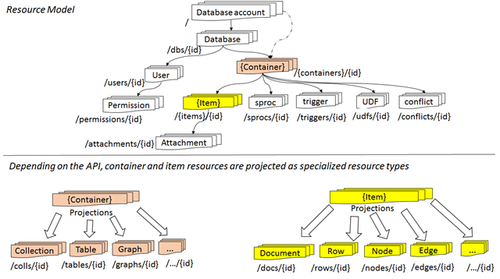
CosmosDB Resource Model
API | Container is projected as … | Item is projected as …
DocumentDB SQL | Collection | Document
MongoDB | Collection | Document
Cassandra | Table | Entity
Azure Table Storage | Table | Item
Gremlin | Graph | Node and Edge

Slide 52
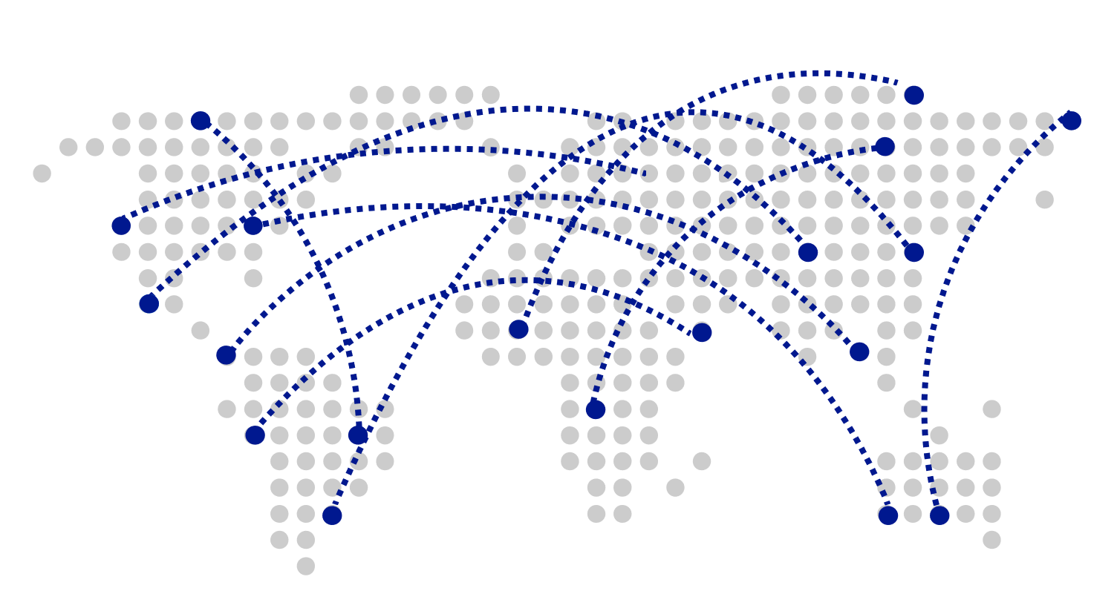
CosmosDB
Turnkey Global Distribution
Worldwide presence as a Foundational Azure service
Automatic multi-region replication
Multi-homing APIs
Manual and automatic failovers
Designed for High Availability
Notes:
Cosmos DB is a Foundational (Ring 0) Azure service
Available in all Azure regions by default, including sovereign/government clouds
Transparent and automatic multi-region replication
Associate any number of regions with your database account, at any time
Policy based geo-fencing
Multi-homing APIs
All endpoints are logical, by default
Apps don’t need to be redeployed during regional failover
Apps can also access physical endpoints if needed
Support for both manual and automatic failover
Designed for high availability
Allows for dynamically setting priorities to regions
Simulate regional disasters via API
Test the end-to-end availability for the entire app (beyond just the database)

Slide 53
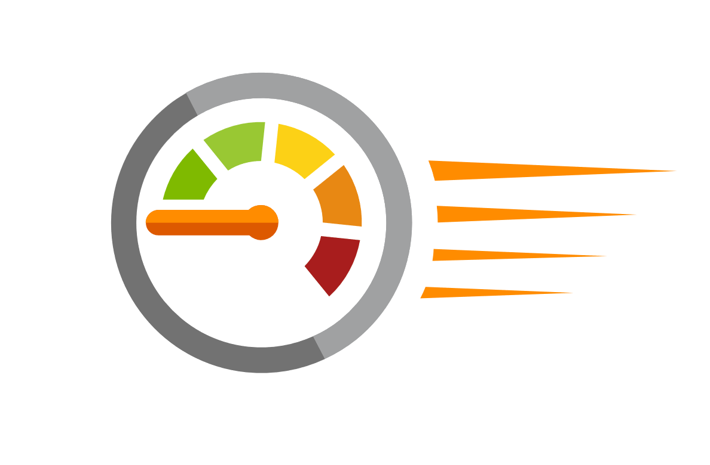
CosmosDB
Guaranteed low latency at P99 (99th percentile)
Requests are served from local region
Single-digit millisecond latency worldwide
Write optimized, latch-free database engine designed for SSD
Synchronous automatic indexing at sustained ingestion rates
Reads
(1KB)
Indexed writes
(1KB)
P50
<2ms
<6ms
P99
<10ms
<15ms
Notes:
Unique design of the quorum based replication protocol
Globally distributed with reads and writes served from local region
Well defined consistency models designed to provide precise consistency guarantees
Unique design of database engine
Write optimized, latch-free database engine designed for SSDs and low latency access
Culmination of decades of database system research in marrying the best of NoSQL techniques for the write path with the Relational query optimized data structures concurrent btree on the read/query path
Benchmarked to have the lowest write and read amplifications.
Better performance and TCO compared to all popular log structured engines LevelDB, RocksDB, TokuDB, WiredTiger
Fully resource governed NO WRITE PAUSES
Synchronous and automatic indexing at sustained ingestion rates
No schema or index management needed
No schema versioning needed
No schema migration needed
All of this is highly relevant for rapidly evolving apps in a globally distributed setup
Cosmos DB guarantees low latency access by serving reads and writes from the local regions. This helps your applications to beat the speed of light or network latency across regions.
Nucleus of Cosmos DB is a write optimized, latch-free database engine which is designed for Solid State Drives. The core design point is low latency and performance and global scale.
Cosmos DB indexes all your data automatically, synchronously at sustained ingestion rates. There is no overhead of secondary indexes as with other databases. Most of us know the pain of managing indexes. Now imagine for a moment maintaining, managing, migrating indexes at global scale. It is almost impossible but with Azure Cosmos DB, you don’t have to. At P99 Cosmos DB guarantees <10ms latency for read access and <15ms for write access. Most applications will experience even lower latency of under <2ms for reads and <6ms for writes.
Several of our large scale cloud services at Microsoft uses Cosmos DB for low latency access. All the device telemetry from windows mobile devices is stored in a globally distributed database and with 100s of millions of devices out there, low latency was a key factor in deciding on the right data store.

Slide 54
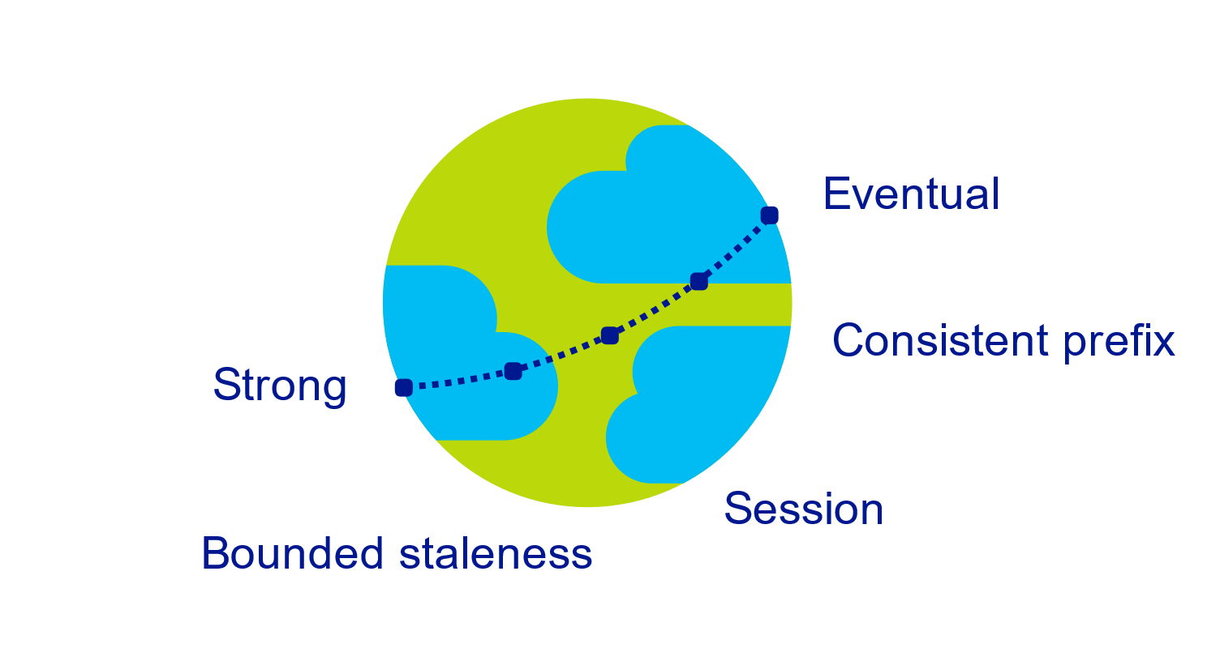
CosmosDB
Multiple, well-defined consistency choices
Global distribution forces us to navigate the CAP theorem
Writing correct distributed applications is hard
Five well-defined consistency levels
Intuitive and practical with clear PACELC tradeoffs
Programmatically change at anytime
Can be overridden on a per-request basis
Notes:
CAP theorem. In other words, the CAP theorem states that in the presence of a network partition, one has to choose between consistency and availability.
Reference: https://en.wikipedia.org/wiki/CAP_theorem
Databases are divided into two categories
Provide extreme choices – strong vs. eventual consistency (e.g., DynamoDB)
Leave everything for developers to configure (e.g., Cassandra)
Read repair, Hinted handoff, quorum sizes, replication topologies etc
Developers have to make precise tradeoffs between
Consistency and availability (during failures)
Consistency and latency (during steady state)
Consistency and throughput (this is important for TCO reasons)
Strong:
Strong consistency offers a linearizability guarantee with the reads guaranteed to return the most recent version of an item.
Strong consistency guarantees that a write is only visible after it is committed durably by the majority quorum of replicas. A write is either synchronously committed durably by both the primary and the quorum of secondaries, or it is aborted. A read is always acknowledged by the majority read quorum, a client can never see an uncommitted or partial write and is always guaranteed to read the latest acknowledged write.
Azure Cosmos DB accounts that are configured to use strong consistency cannot associate more than one Azure region with their Azure Cosmos DB account.
The cost of a read operation (in terms of request units consumed) with strong consistency is higher than session and eventual, but the same as bounded staleness.
Bounded staleness:
Bounded staleness consistency guarantees that the reads may lag behind writes by at most K versions or prefixes of an item or t time-interval.
Therefore, when choosing bounded staleness, the "staleness" can be configured in two ways: number of versions K of the item by which the reads lag behind the writes, and the time interval t
Bounded staleness offers total global order except within the "staleness window." The monotonic read guarantees exists within a region both inside and outside the "staleness window."
Bounded staleness provides a stronger consistency guarantee than session or eventual consistency. For globally distributed applications, we recommend you use bounded staleness for scenarios where you would like to have strong consistency but also want 99.99% availability and low latency.
Azure Cosmos DB accounts that are configured with bounded staleness consistency can associate any number of Azure regions with their Azure Cosmos DB account.
The cost of a read operation (in terms of RUs consumed) with bounded staleness is higher than session and eventual consistency, but the same as strong consistency.
Session:
Unlike the global consistency models offered by strong and bounded staleness consistency levels, session consistency is scoped to a client session.
Session consistency is ideal for all scenarios where a device or user session is involved since it guarantees monotonic reads, monotonic writes, and read your own writes (RYW) guarantees.
Session consistency provides predictable consistency for a session, and maximum read throughput while offering the lowest latency writes and reads.
Azure Cosmos DB accounts that are configured with session consistency can associate any number of Azure regions with their Azure Cosmos DB account.
The cost of a read operation (in terms of RUs consumed) with session consistency level is less than strong and bounded staleness, but more than eventual consistency
Consistent Prefix:
Consistent prefix guarantees that in absence of any further writes, the replicas within the group eventually converge.
Consistent prefix guarantees that reads never see out of order writes. If writes were performed in the order A, B, C, then a client sees either A, A,B, or A,B,C, but never out of order like A,C or B,A,C.
Azure Cosmos DB accounts that are configured with consistent prefix consistency can associate any number of Azure regions with their Azure Cosmos DB account.
Eventual:
Eventual consistency guarantees that in absence of any further writes, the replicas within the group eventually converge.
Eventual consistency is the weakest form of consistency where a client may get the values that are older than the ones it had seen before.
Eventual consistency provides the weakest read consistency but offers the lowest latency for both reads and writes.
Azure Cosmos DB accounts that are configured with eventual consistency can associate any number of Azure regions with their Azure Cosmos DB account.
The cost of a read operation (in terms of RUs consumed) with the eventual consistency level is the lowest of all the Azure Cosmos DB consistency levels.

Slide 55

CosmosDB
Elastically scalable storage and throughput
Single machine is never a bottle neck
Transparent server-side partition management
Elastically scale storage (GB to PB) and throughput (100 to 100M req/sec) across many machines and multiple regions
Automatic expiration via policy based TTL
Pay by the hour, change throughput at any time for only what you need
Support for both request per second and requests per minute to handle spikes cost-effectively
12000000
10000000
8000000
6000000
4000000
2000000
Black Friday
Provisioned request / sec
Nov 2016
Dec 2016
Time
Hourly throughput (request/sec)
Notes:
Single machine is never a bottleneck
A single table can scale from GB-PBs, across many machines, and regions
Transparent server side partition management and routing
Optionally evict old data using built-in support for TTL
Customers pay only for the throughput and storage they need
Elastically scale throughput from 10 to 100s of millions of requests/sec across multiple regions
Support for requests/sec and requests/min for different workloads
This ensures that never have to provision for the peak
Customers pay only for the throughput and storage they need
Customers pay by the hour for the provisioned throughput

Slide 56
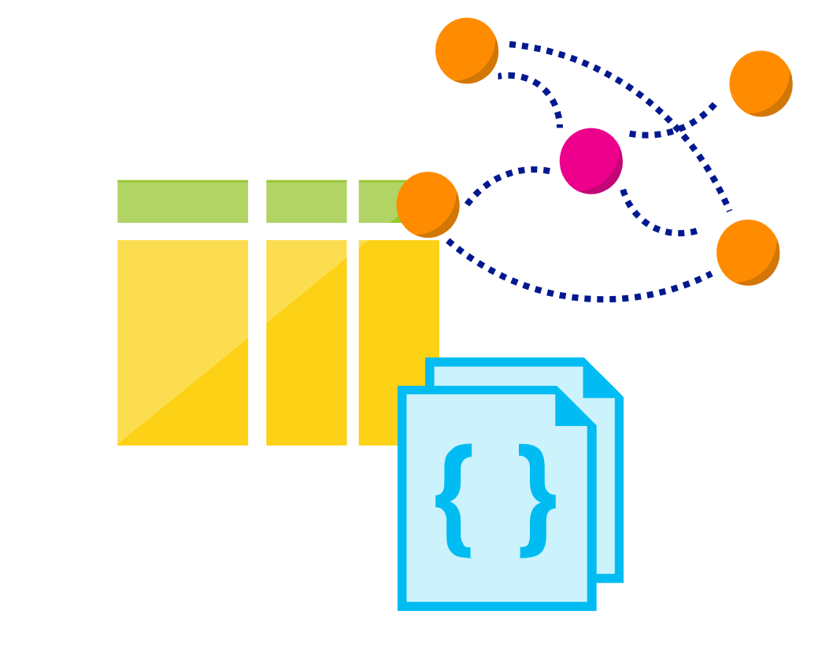
CosmosDB
Multi-model, multi-API
Database engine operates on Atom-Record-Sequence type system
All data models can be efficiently translated to ARS
Multi-model: Key-value, Document, and Graph
Multi-API: SQL (DocumentDB), MongoDB, Table, and Gremlin
More data-models and APIs to be added
Notes:
Azure Cosmos DB natively supports multiple data models including documents, key-value, graph, and column-family. The core content-model of Cosmos DB’s database engine is based on atom-record-sequence (ARS). Atoms consist of a small set of primitive types like string, bool, and number. Records are structs composed of these types. Sequences are arrays consisting of atoms, records, or sequences.
The database engine can efficiently translate and project different data models onto the ARS-based data model. The core data model of Cosmos DB is natively accessible from dynamically typed programming languages and can be exposed as-is as JSON.
The service also supports popular database APIs for data access and querying. Cosmos DB’s database engine currently supports DocumentDB SQL, MongoDB, Azure Tables(preview), and Gremlin (preview). You can continue to build applications using popular OSS APIs and get all the benefits of a battle-tested and fully managed, globally distributed database service.

Slide 57
CosmosDB
Schema-agnostic, automatic indexing
At global scale, schema/index management is painful
Automatic and synchronous indexing
Hash, range, and geospatial
Works across every data model
Highly write-optimized database engine
Schema
Physical index
Notes:
At global scale, schema/index management is hard
Automatic and synchronous indexing of all ingested content - hash, range, geo-spatial, and columnar
No need to define schemas or secondary indices upfront
Resource governed, write optimized database engine with latch free and log structured techniques
Online and in-situ index transformations

Slide 58
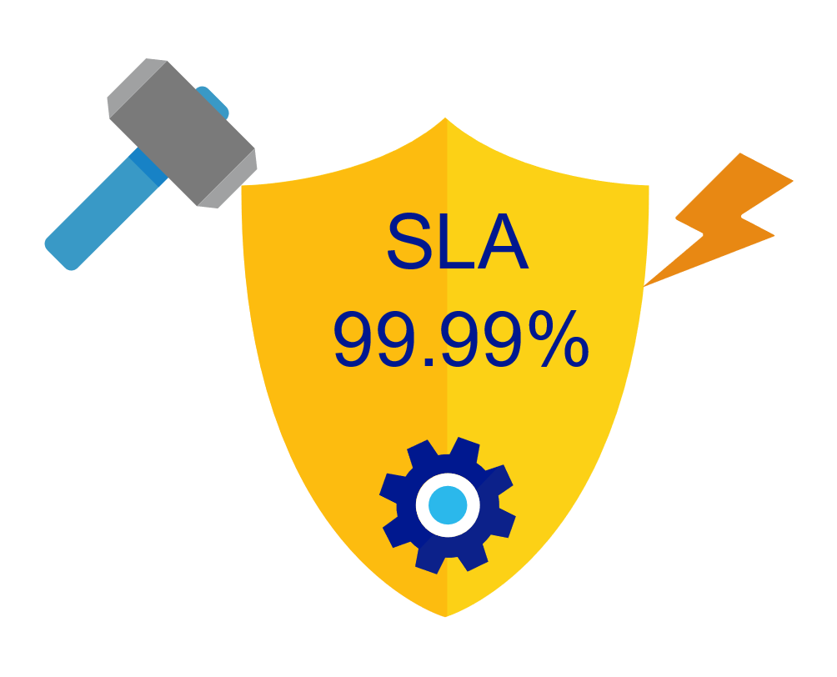
CosmosDB
Industry-leading, enterprise-grade SLAs
99.99% availability – even with a single region
Made possible with highly-redundant storage architecture
Guaranteed durability – writes are majority quorum committed
First and only service to offer SLAs on:
Low-latency
Consistency
Throughput
Notes:
Globally distributed database needs to tackle
latency vs. consistency tradeoffs (in steady state)
availability vs. consistency tradeoff (during failures)
throughput vs. consistency tradeoffs during all times
throughput vs. latency tradeoffs during all times
Simply offering high availability SLAs are not sufficient!
Cosmos DB:
99.99% HA within a single region
99.99 SLA throughput, latency, consistency all at the 99th percentile

Slide 59

CosmosDB
Security & Compliance
Always encrypted at rest and in motion
Fine grained “row level” authorization
Network security with IP firewall rules
Comprehensive Azure compliance certification:
ISO 27001
ISO 27018
EUMC
HIPAA
PCI
SOC1 and SOC2
Notes:
As a foundational Azure Service, Security and Compliance is an important aspect of Azure Cosmos DB. Several high value Microsoft services that have stringent compliance and security requirements are built on Azure Cosmos DB. All of the data is encrypted at rest and it is enabled by default. We made sure that we continue to provide the performance guarantees even with encryption enabled and this is transparent to your application.

Slide 60
CosmosDB
Lowest Total Cost of Ownership (TCO)
$
10x
Deeply exploit cloud core properties and economies of scale
Significantly cheaper than DynamoDB, Cassandra, Cloud Spanner and MongoDB
Designed from the ground up as a multi-tenant service with end-to-end resource governance to provide performance isolation.
Fully managed as a service - much lower operation cost
Cost
$
3x
Cosmos DB
DynamoDB
On-premises
MongoDB/
Cassandra
Notes:
(Cosmos DB more cost effective than their OSS counter-parts running on-premises or virtual machines)
The TCO for Azure Cosmos DB and AWS DynamoDB in this moderate scenario were comparable, with Azure Cosmos DB slightly (~10%) cheaper due to lower costs for write requests.
Cosmos DB TCO is comparable to that of OSS Cassandra running on Azure D14v2 VMs for scenarios involving high sustained pre-dominantly write workloads with low storage needs
Balanced read / write mix workload or bursty workload - Cosmos DB TCO can be up to 4 time lower than OSS Cassandra running on Azure VMs
However, the non-trivial dev/ops cost component brings the total cost of ownership of Cassandra deployment higher

Slide 61
Design for Azure Data Services

Slide 62
Additional Azure Services Included
Data Catalog
Azure Data Factory
SQL Data Warehouse
Azure Data Lake Analytics
Azure Analysis Services
Azure HDInsight

Slide 63
Hands-on Labs

Slide 64
Labs
Create a storage account
https://docs.microsoft.com/en-us/azure/storage/common/storage-quickstart-create-account?toc=%2Fazure%2Fstorage%2Fblobs%2Ftoc.json&tabs=portal
Upload, download, and list blobs using the Azure portal
https://docs.microsoft.com/en-us/azure/storage/blobs/storage-quickstart-blobs-portal
Create an Azure SQL database in the Azure portal
https://docs.microsoft.com/en-us/azure/sql-database/sql-database-get-started-portal
Use the SQL Query editor to connect and query data
https://docs.microsoft.com/en-us/azure/sql-database/sql-database-connect-query-portal

